Slide 1
Two Simple Project Economic Analysis Examples

Slide 2
Expected Value
A pick-3 lottery costs $1 to enter. If you match all three digits you get $500 otherwise nothing. What can you expect if you play this lottery by buying one ticket?
    0.1% of the time (1 out of 1,000) you will match 3 digits and end up $499 ahead (the $500 prize less the $1 entry)
    99.9% of the time you end up behind $1 for entering the lottery
    Your ‘expected value’ is .001 * 499 + .999 * -1 = -.50
  On average you lose $0.50 every time you play this lottery (typical for most state lotteries). Ironically, this is called ‘expected value’ even though never really expect to see this particular result; it’s really a long-term average.

Slide 3
Weighted Average
Assuming you can
Identify the possible (mutually exclusive, exhaustive) outcomes of a project, e.g., outcomes 1 thru n
Derive or estimate the likelihood of each outcome (the sum of which should be 1.0 since the list of outcomes is mutually exclusive and exhaustive), e.g., p₁ thru p_{n}
Derive or estimate the value, usually in money, resulting from each outcome, e.g., v₁ thru v_{n}
the expected value is the weighted average of the values using the likelihoods as weights
EV = p₁v₁ + … p_{n}v_{n}
Not perfect but a standard, effective way to help address uncertainty in outcomes.

Slide 4
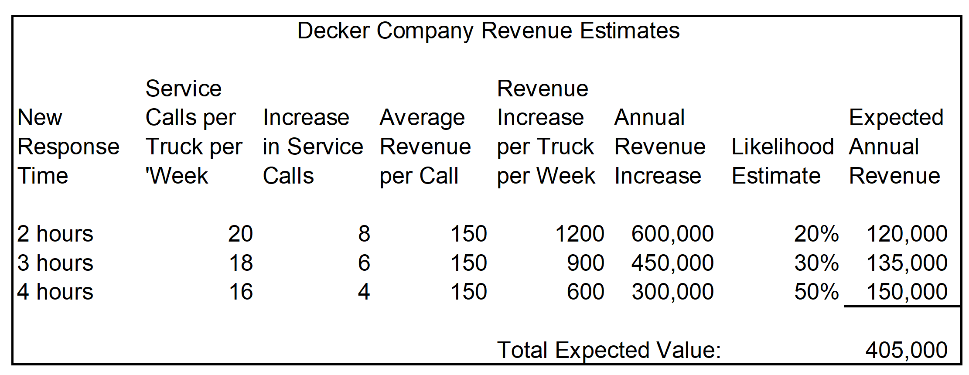
SAD Chapter 1, Mini-Case 3

Slide 5
Present Value Concept
Key principle: A dollar paid to you in the future does not have the same worth, almost always less or discounted, than a dollar you have or are paid today. Why?
Inflation: If annual inflation is 8% then what – on average – costs $1.00 now will cost $1.08 in a year. So, $1.00 paid to you in a year is worth $1*(1.00 / 1.08) ≈ $.93 … a dollar in one year will have 93 cents of buying power in todays terms.
Opportunity: If investments can return 10% annually then (about) $.91 ≈ $1*(1.00/1.10) could be invested now to have $1 in a year, so a dollar next year is worth 91 cents today.
Risk: If there is a 2% chance annually that a dollar promised in a year won’t be paid back then the expected value of $1 next year is 98 cents today (.98*1 + .02*0) or, using ‘odds’ of .02/(1-.02) ≈ .0204, $98 ≈ $1*(1.00/1.0204).
In each case $1 in a year is worth 1/(1+r) dollars in a year for a ‘discount rate’ r (inflation, opportunity for gains, odds of no payback; often, a combination). With compounding, a dollar in n years is worth 1/(1+r)^{n} dollars now.

Slide 6
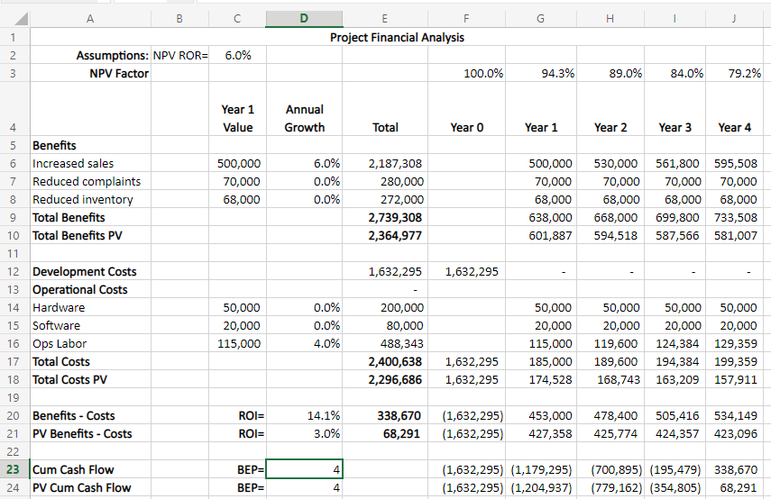
Project NPV Worksheet

