Slide 1

Requirements & Ambiguity
Observations and comments taken and adapted from an excellent, legacy (published 1989) book on the topic by Gause and Weinberg.

Slide 2
A few adages by way of setting
If you don’t know where you are going, any road will get you there.
Lewis Carroll
If you don’t know where you are going, you will end up someplace else.
Yogi Berra
Your potential, our passion; Where are you going today?
Microsoft slogans
People don’t know what they want until you show it to them.
Steve Jobs
If people don’t know what they want, no development process will satisfy them.
Gause & Weinberg
Without requirements (of some sort) there can be no useful system development.

Slide 3
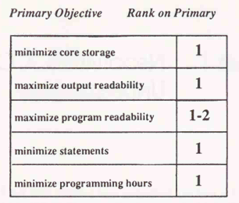
Developers historically deliver on requirements
Experiments where the same requirements are given to different teams but with a different requirement identified as primary led to designs and working systems where the primary requirement was met with (nearly) first rank.
Key takeaways:
If you tell what you want, you are likely to get it.
If you don’t tell what you want, you are unlikely to get it.

Slide 4

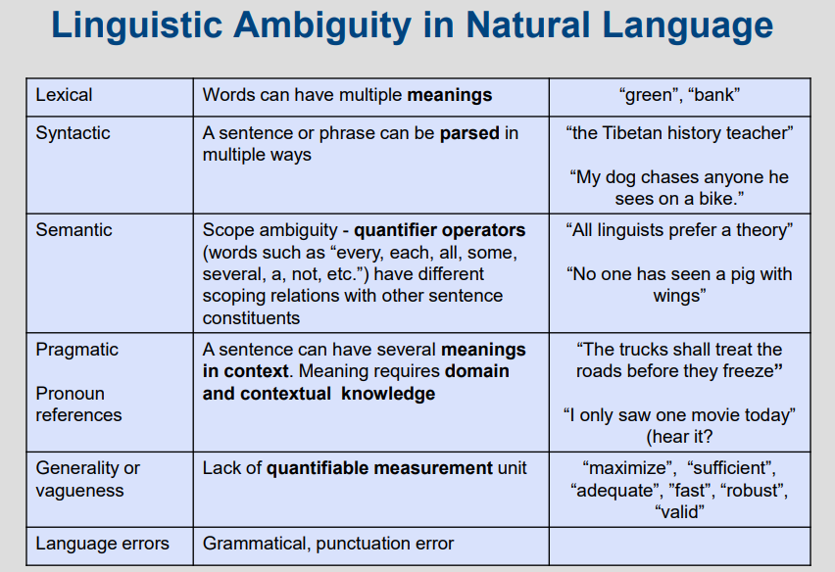
Ambiguity -- ‘What happens in vagueness stays in vagueness’
Ambiguity: the quality of being open to more than one interpretation; inexactness
Example requirement: Create a means for protecting a small group of human beings from the hostile elements of their environment.
Missing information: How long? Nature of environment? …
Introduced elements: Is a structure implied? Is moving away excluded? …
Ambiguous words: small, group (implying interaction), hostile …
Diverse interpretations: Legal protection from litigants? Protection (e.g., a fence) from intruders …

Slide 5
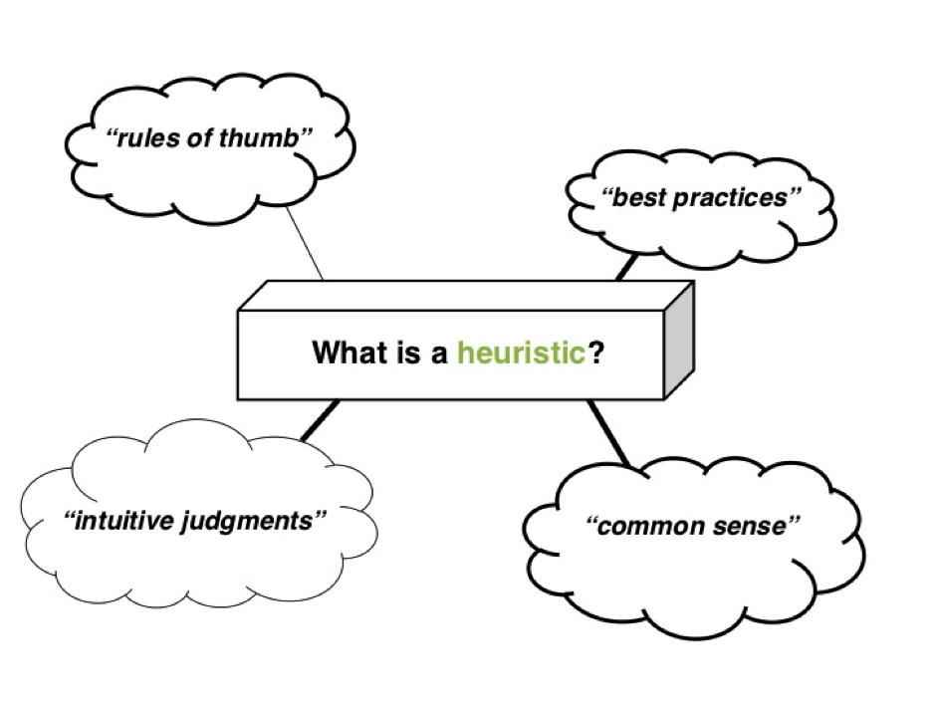
Four heuristics for addressing ambiguity
Ambiguity poll heuristic
Memorization heuristic
‘Mary had a little lamb’ heuristic
‘Mary conned the trader’ heuristic

Slide 6
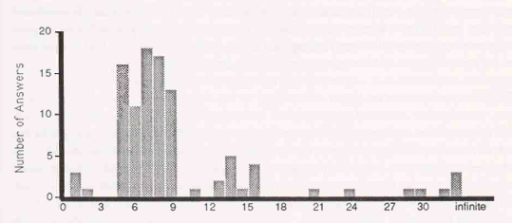
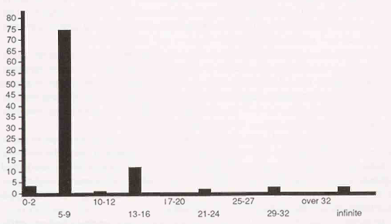
Ambiguity poll heuristic
Poll participants on some aspect of the requirement (e.g., how long will it take or how much will it cost). Top diagram suggests significant ambiguity among the participants whereas bottom shows better core consensus on understanding the requirement. Discussion about differences can help reduce the variations in understanding.

Slide 7

Memorization heuristic
Take away a written requirement and ask participants to write down – from memory – what the requirement asked. Places where recall differs are ambiguous, error-prone areas of the requirement. Often, few people look back at the written requirement depending on their memory of it so an easily memorized requirement can be very effective in reducing ambiguity.
Gratuitous eye candy helping to fill an otherwise tedious slide. Apologies.

Slide 8

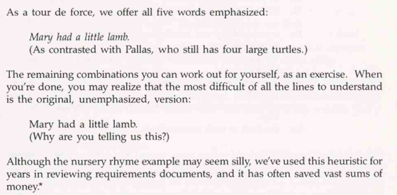
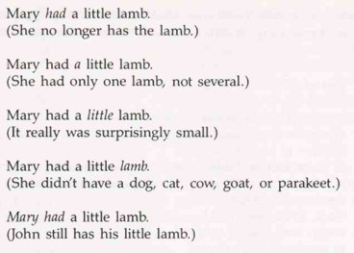
‘Mary had a little lamb’ heuristic
Emphasize individual words and phrases to see if different meanings emerge; if so, try to reduce the ambiguity in understanding. From the referenced text:

Slide 9
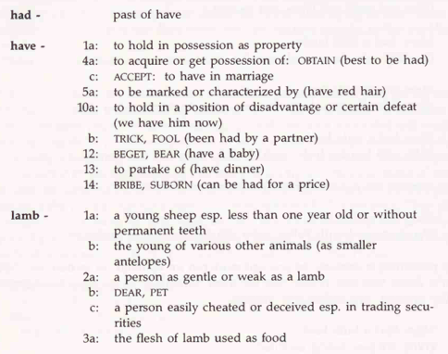
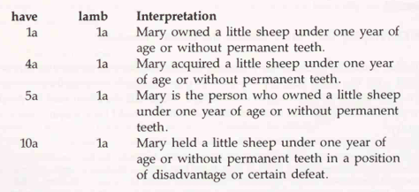
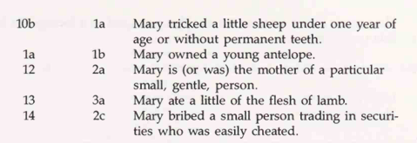
‘Mary conned the trader’ heuristic
Try synonyms and other meanings for words in the requirement to derive other interpretations; this may indicate ambiguity in the statement. From the text:

Slide 10
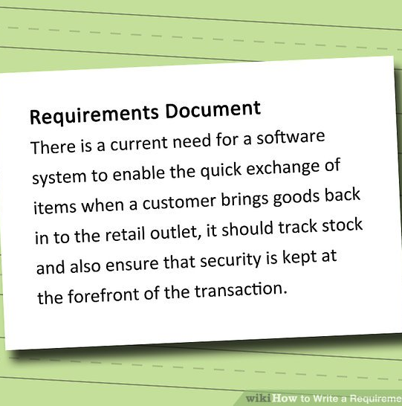
Per the text authors
“Teach these heuristics to everyone who will ever have to construct or interpret a requirements document”

