Slide 1
Data Normalization And Related Topics

Slide 2
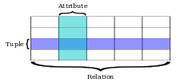
Yet Another DB Example
Accelerated Reader
Students choose & read books, earning points for prizes based on a test on the book.
Pts Earned = AR Factor * Book Points * Test Points / 100
In database theory, a relation, as originally defined by E. F. Codd,^{[1]} is a set of tuples (d₁, d₂, ..., d_{n}), where each element d_{j} is a member of D_{j}, a data domain. From Wikipedia
Metadata: Data about data – entity (relation), attributes (columns), attribute domains (types)

Slide 3
Requirements for a Data Relation (Not Relationship)
A unique name for the entity (table, list) among all entities
Sequence of columns (attributes, fields) with unique column names
No row (tuple, record, instance) can be a duplicate
Each cell (field) must contain a single ‘atomic’ value
A values in a column must be the same data type
https://www.lifewire.com/relation-definition-1019260

Slide 4
Example Relation in First Normal Form (1NF)
ARTest
‘First normal form’ is a relation with no repeating fields and a primary key
1NF is a conceptual step in DB design (i.e., you don’t build a 1NF DB, you use the idea to refine your data model)
A fully relational design can be denormalized to 1NF (or similar) for analysis (e.g., think of Excel pivot tables)
1NF is a ‘well structured’ list but as way to store data can suffer from ‘anomalies’
Insert: What to do with new students or books without tests?
Delete: If Tammy leaves and we delete her rows, we’ve lost facts that 2nd grade has a 90% factor and Paradise Lost is a 1000 point book
Update: If we conclude Bunny’s Adventure is really a 150 point read, we must make several updates to change one fact

Slide 5
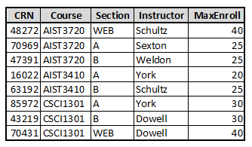
A Digression on Keys
A key (in general though ‘key’ usually means ‘primary key’) is a subset of a relation’s attributes; specification of values for the key attributes defines a subset of the rows of the table. For instance [Section,Instructor] is a key and values (‘A’,’York’) for the key determines a subset containing two rows from the table. The ‘empty key’ (i.e., specifying no attributes or values) determines a subset containing all rows. In general, there are 2^{n} potential keys for a table, where n is the number of attributes in the relation.
A super key determines a unique record, as does a candidate key or a primary key. A super key may have attributes not required for uniqueness (e.g., [CRN,Instructor] is a super key but [CRN] by itself uniquely identifies a record). A candidate key is a ‘minimal’ super key where all the key attributes are required for uniqueness (e.g., [Course,Section] is a candidate key – uniquely defines a record – but [Course] or [Section] alone do not. A primary key is one candidate key chosen as the ‘main’ identifier for the table. A multi-key can, in general, identify a set of more than 1 record (e.g., [Section] is a multi-key since value (‘B’) for it returns 3 records).
A composite key contains more than one attribute (e.g., [Course,Section] is composite but [MaxEnroll] is not). A surrogate key is a ‘made up value’ (usually integer) added to a relation to guarantee a unique key (e.g., [CRN]). A foreign key is an attribute in another table that refers to the primary key (e.g., using [CRN] in a student schedule to ‘look up’ the Instructor and MaxEnroll for the course)

Slide 6
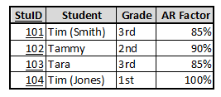
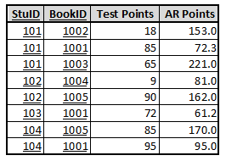
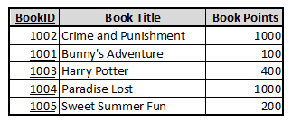
Refining 1NF to 2NF (Second Normal Form)
ARTest
If a 1NF relation does not have a composite key, it’s already in 2NF.
If not, move attributes that are ‘functionally dependent’ on only part of the key to their own tables or calculate when needed.
Student
ARTest
Book
1:N
N:1
Several anomalies addressed (e.g., new student or book) and less redundancy. Still deletion and update anomalies with Grade & AR Factor and AR Points.

Slide 7
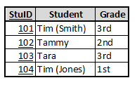
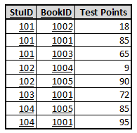
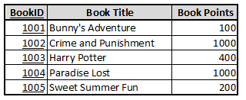
Refining 2NF to 3NF (Third Normal Form)
Student
ARTest
Book
1:N
N:1
ARFactor
1:N
Any 2NF attributes functionally dependent on other non-key attributes should be moved to their own table (e.g., ARFactor) or removed because they can be calculated as needed (e.g., AR Points in ARTest).
There are other levels of refinement: Boyce-Codd NF and 4th, 5th, 6th normal forms
3NF is considered the ‘sweet spot’ for data modeling, addressing most concerns
Complex models – especially those with several candidate keys – may require refinement beyond 3NF but introductory illustrative examples are a challenge to develop
In short – for all normal forms and relational database models A relation’s attributes will depend on the (primary) key, the whole key and nothing but the key, so help me Codd.

