Slide 1
Many to Many Relationships in Relational Databases

Slide 2
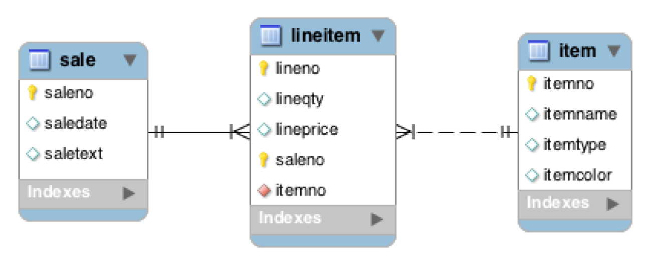
Sales Order Example
M:M relationships can’t be implemented directly in a relational DBMS
An additional associative entity with two 1:M relationships is used
Associative entities typically have a composite primary key with one or more PK attributes matching other entity PK’s (e.g., the + notation)
A weak entity (e.g., lineitem) relies on other entities (e.g., sale) for its ‘existence’
When used, a dashed lines (e.g., lineitem to item) indicate non-identifying relationships

Slide 3
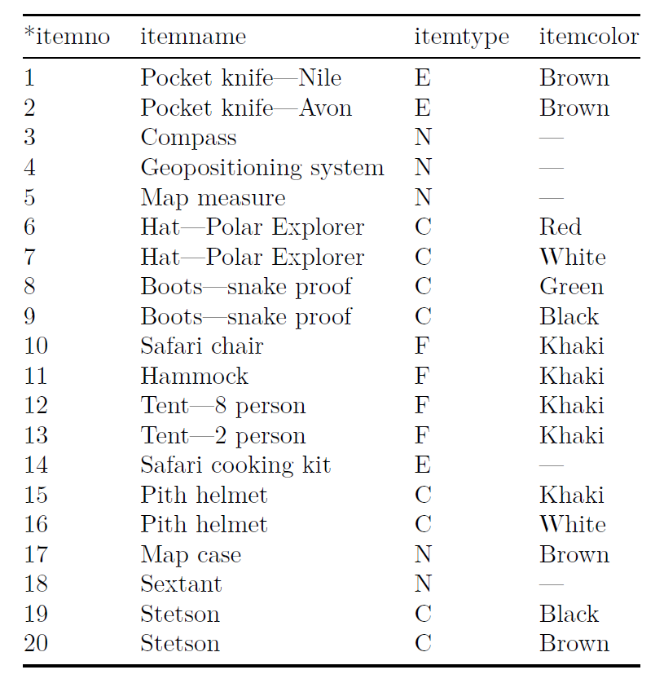
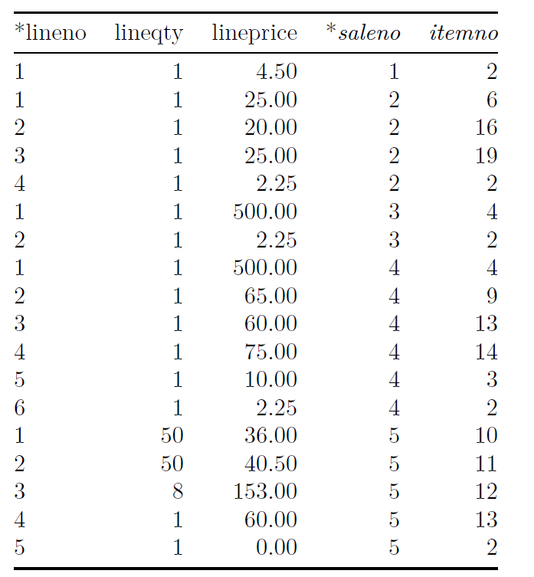
Sales Order Example
Sale
Item
LineItem

Slide 4
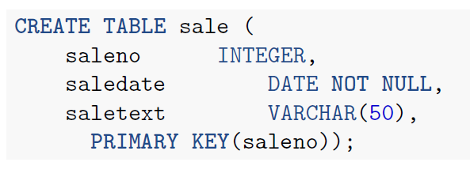
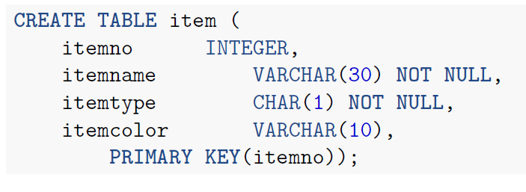
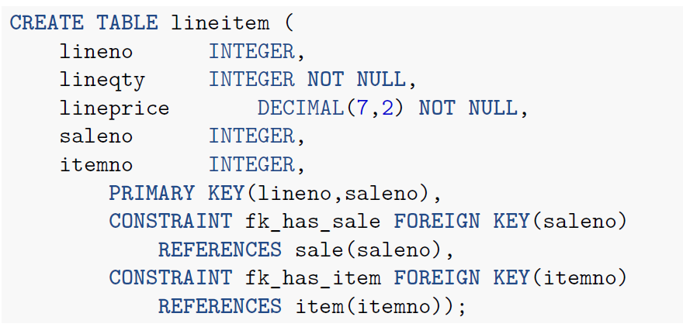
Sales Order Example

Slide 5
Modeling M:M Relationships
Generate examples
Look for nouns
Draw main entities
Add associative entities where M:M
Draw relationships
Adjust cardinalities
For instance
Basic burger: bun, patty
Basic deluxe: bun, patty, lettuce, tomato
Vegan: Dave’s killer bread, lettuce, tomato
Diet delite: lettuce, tomato

